Slide 1
DATA VISUALIZATION
Below data is dependent on sales of super stores ,with different productline,payment type ,customer s, gender, from 3 different areas and different branches.
Below project is visualization and data understanding for whole data set of sales of super stores using graphs, pie chart etc.

Slide 2
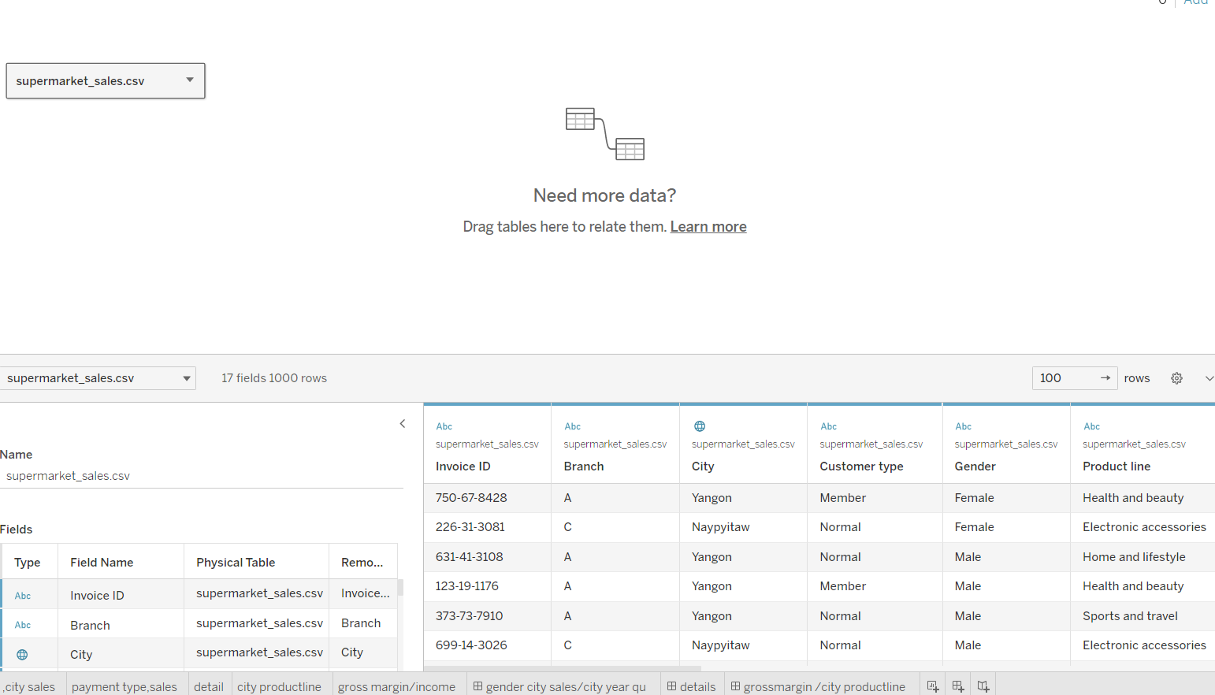
DATASET

Slide 3
WHAT IS QUANTITY OF SALES IN CITIES ?
DISCRIMINATION BETWEEN TYPE OF CUSTOMER BUYING GOODS FROM STORES?
CLASSIFICATION OF CUSTOMERS BUYING FROM EACH CITY?
WHAT IS TYPE OF METHODS USED FOR PAYMENT FOR PRODUCTLIN?
WHAT IS DETAILS OF PRODUCT LINES SALES IN DIFFERENT ARES?
SALES OF PRODUCTLINE IN YANGONG?
SALES OF PRODUCTLINE IN MANDALAY?
SALES OF PRODUCTLINE IN NAYPITAW?
WHAT IS MAXIMUM,MINIMUM,AVERAGE SALES OF PRODUCTLINE IN CITIES?
EXPLIAN GROSS INCOME ON GROSS MARGIN CHART?
DASHBOARD

Slide 4
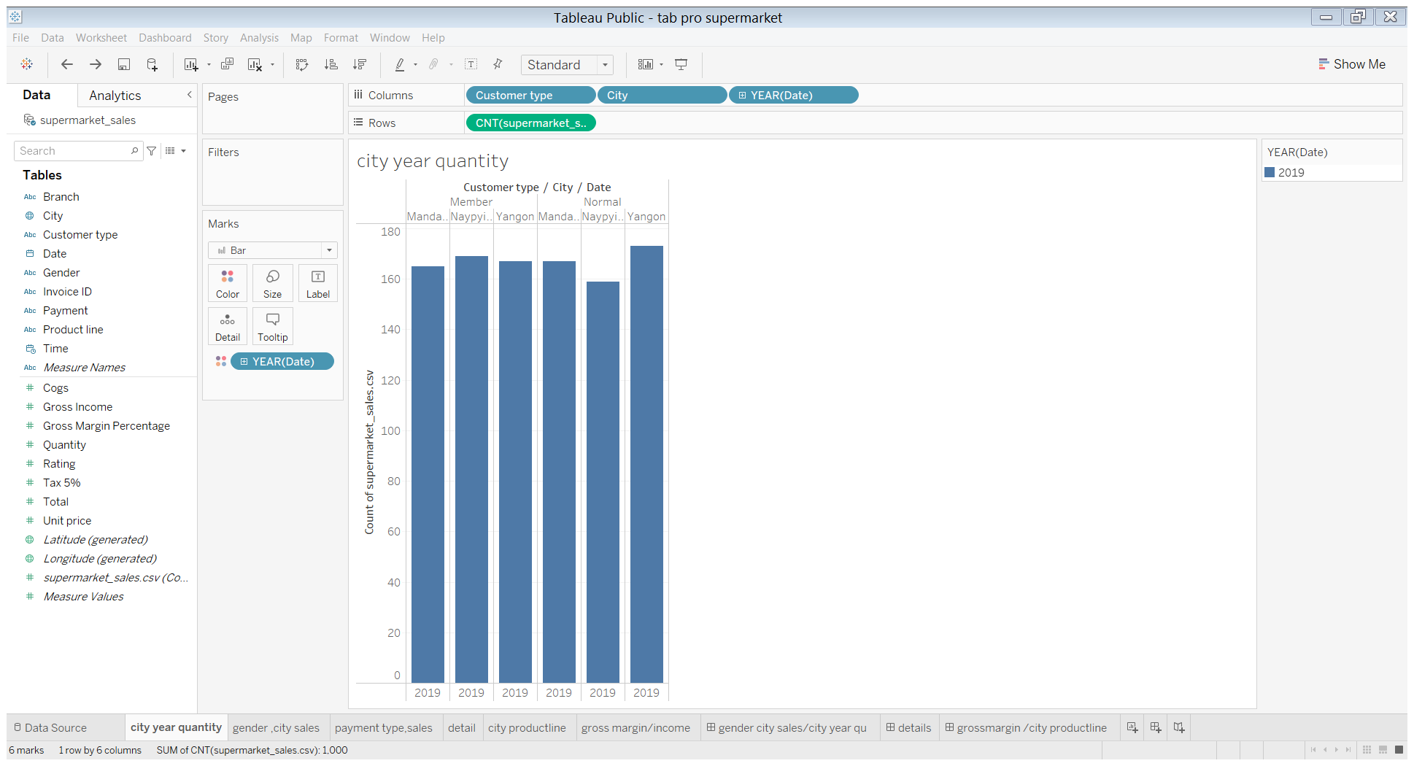
WHAT IS QUANTITY OF SALES IN CITIES ?

Slide 5
IN ABOVE GRAPH WE CAN SEE CUSTOMERS WITH MEMBERSHIP IN MANDALAY
REGION HAS TOTAL QUANTITY PURCHASE OF I65.
MEMBERSHIP CUSTOMERS FROM NAIPAYITAW REGION HAD TOTAL QUANTITY PURCHASE OF 169.
MEMBERSHIP CUSTOMERS FROM YONONG REGION HAD TOTAL QUANTITY PURCHASE OF 167.
NORMAL CUTOMERS FROM MANDALAY REGION HAD TOTAL PURCHASE OF 167
NORMAL CUSTOMERS FROM NAIPAYITAW REGION HAD TOTAL SALES OF 159
NORMAL CUSTOMERS FROM YONONG REGION HAD TOTAL SALES OF 173

Slide 6
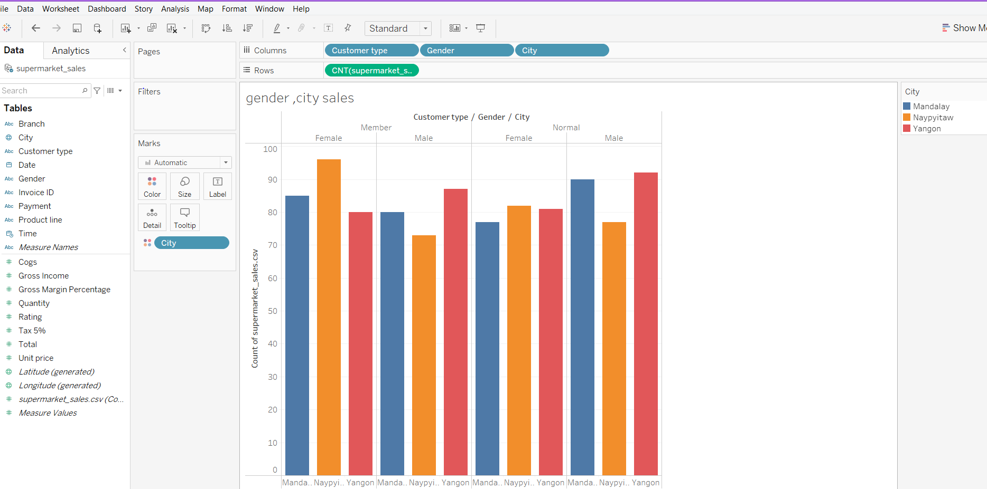
DISCRIMINATION BETWEEN TYPE OF CUSTOMER BUYING GOODS FROM STORES?

Slide 7
IN ABOVE GRAPH WE UNDERSTAND THAT FEMALES FROM NAYPITAW REGION HAD LARGEST PURCHASE ,WITH TOTAL 96 QUANTITY , YONONG HAD TOTAL PURCHASE OF 80,MANDALAY HAD TOTAL PURCHASE OF 85,WITH ALL MEMBERSHIP.
MALES FROM YANGONG REGION HAD LARGEST PURCHASE ,WITH TOTAL 87 QUANTITY , NAYPITAW HAD TOTAL PURCHASE OF 73,MANDALAY HAD TOTAL PURCHASE OF 80,WITH ALL MEMBERSHIP.
FEMALES FROM NAYPITAW REGION HAD LARGEST PURCHASE ,WITH TOTAL 82 QUANTITY , YONONG HAD TOTAL PURCHASE OF 81,MANDALAY HAD TOTAL PURCHASE OF 77,WITH ALL NON MEMBERSHIP.
MALES FROM YANGONG REGION HAD LARGEST PURCHASE ,WITH TOTAL 92 QUANTITY , NAYPITAW HAD TOTAL PURCHASE OF 77,MANDALAY HAD TOTAL PURCHASE OF 90,WITH ALL NON MEMBERSHIP.

Slide 8
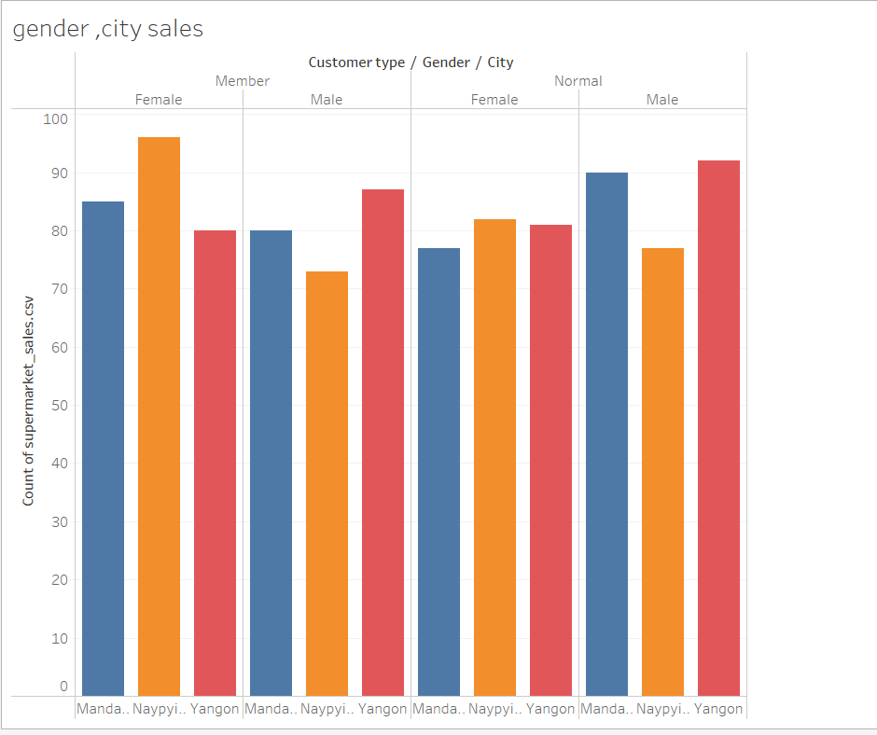
CLASSIFICATION OF CUSTOMERS BUYING FROM EACH CITY?

Slide 9
IN ABOVE GRAPH THERE IS DETAIL INFORMATION OF WHAT TYPES OF CUTOMERS FROM WHICH AREA HAVE BOUGHT AND IN WHAT QUANTITY
YOU CAN FIND MEMBERSHIP CLASSIFICATION IN MALES AND FEMALES WHO ARE BUYING THE PRODUCTS FROM THE CITIES
YOU CAN ALSO FIND NON MEMBERSHIP CLASSIFICATION IN MALES AND FEMALES WHO ARE BUYING THE PRODUCTS FROM THE CITIES

Slide 10
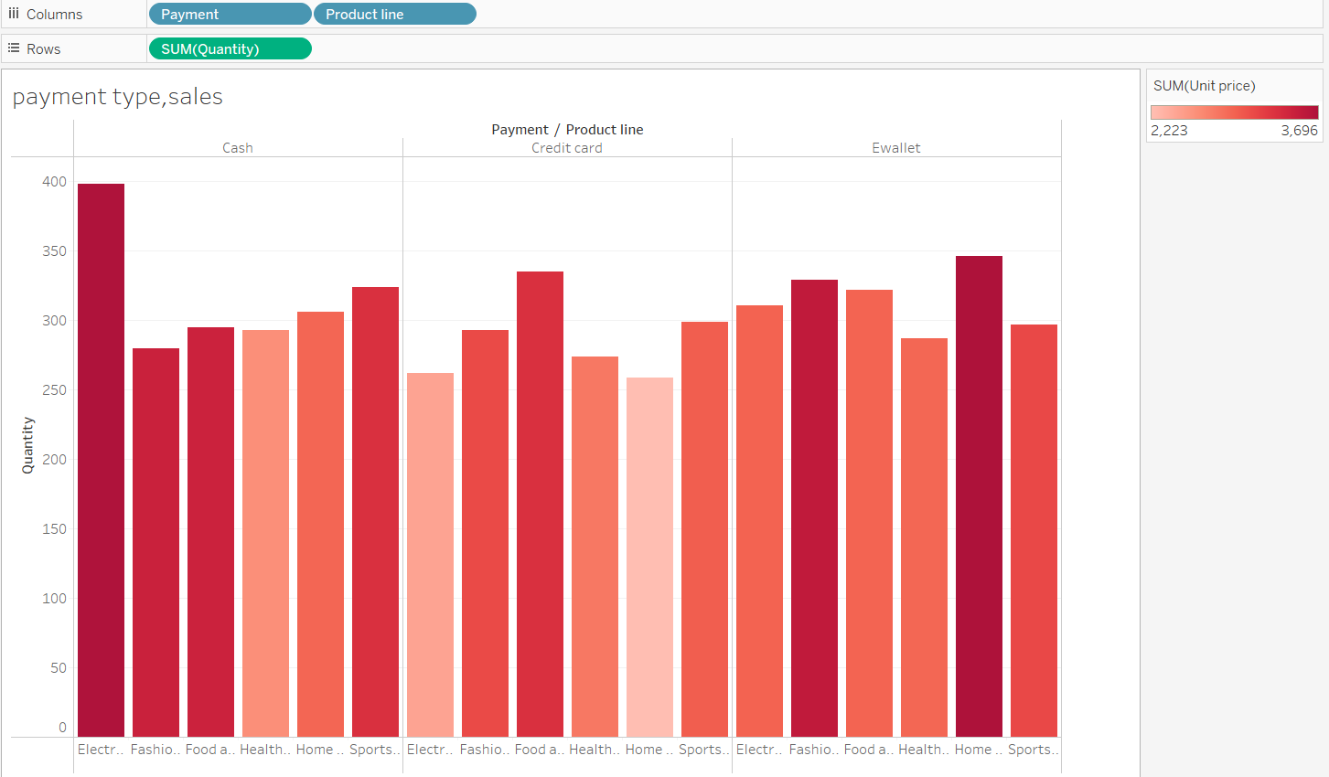
WHAT IS TYPE OF METHODS USED FOR PAYMENT FOR PRODUCTLIN?

Slide 11
WHAT IS DETAILS OF PRODUCT LINES SALES IN DIFFERENT ARES?
SALES OF PRODUCTLINE IN YANGONG?
SALES OF PRODUCTLINE IN MANDALAY?
SALES OF PRODUCTLINE IN NAYPITAW?

Slide 12
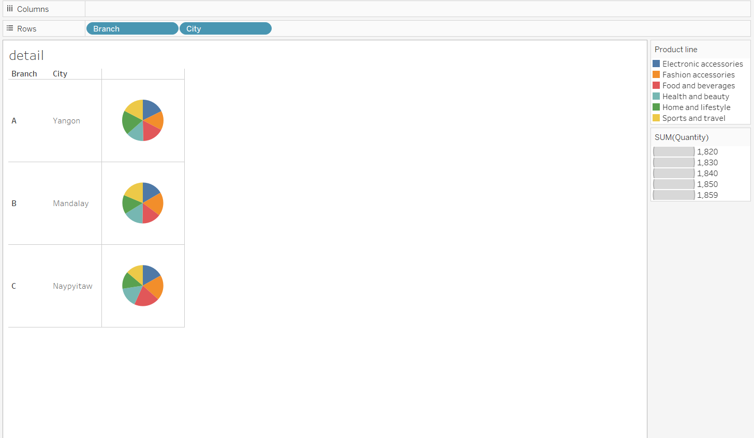

Slide 13
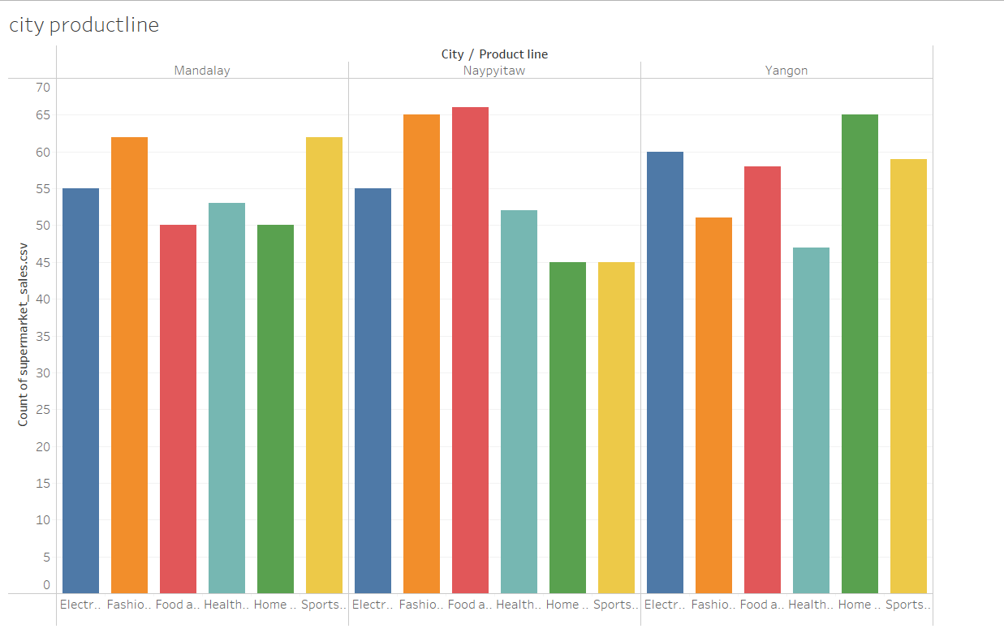
WHAT IS MAXIMUM,MINIMUM,AVERAGE SALES OF PRODUCTLINE IN CITIES?

Slide 14
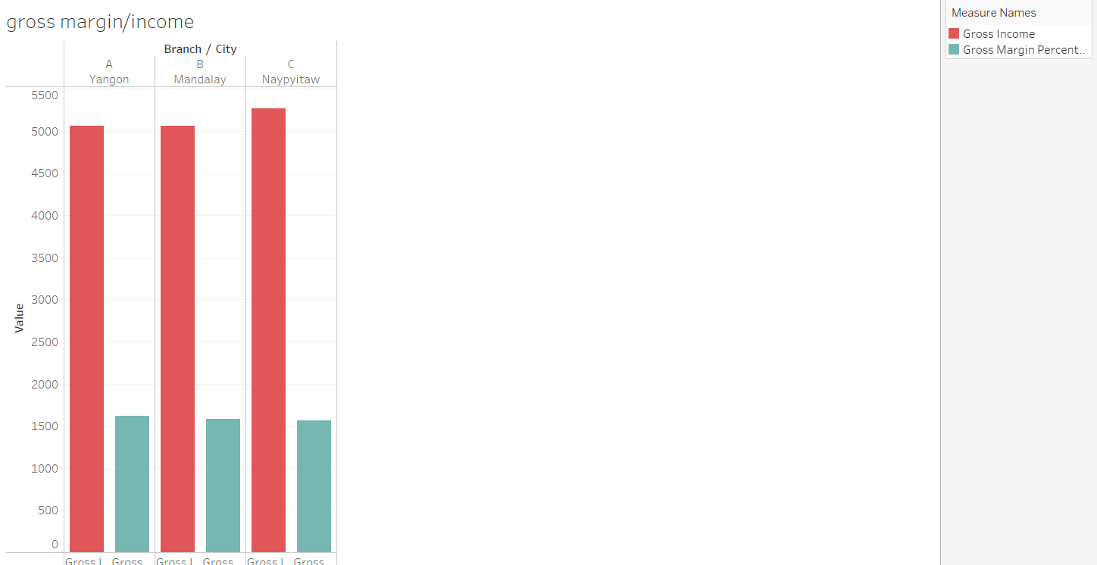
EXPLIAN GROSS INCOME ON GROSS MARGIN CHART?

Slide 15
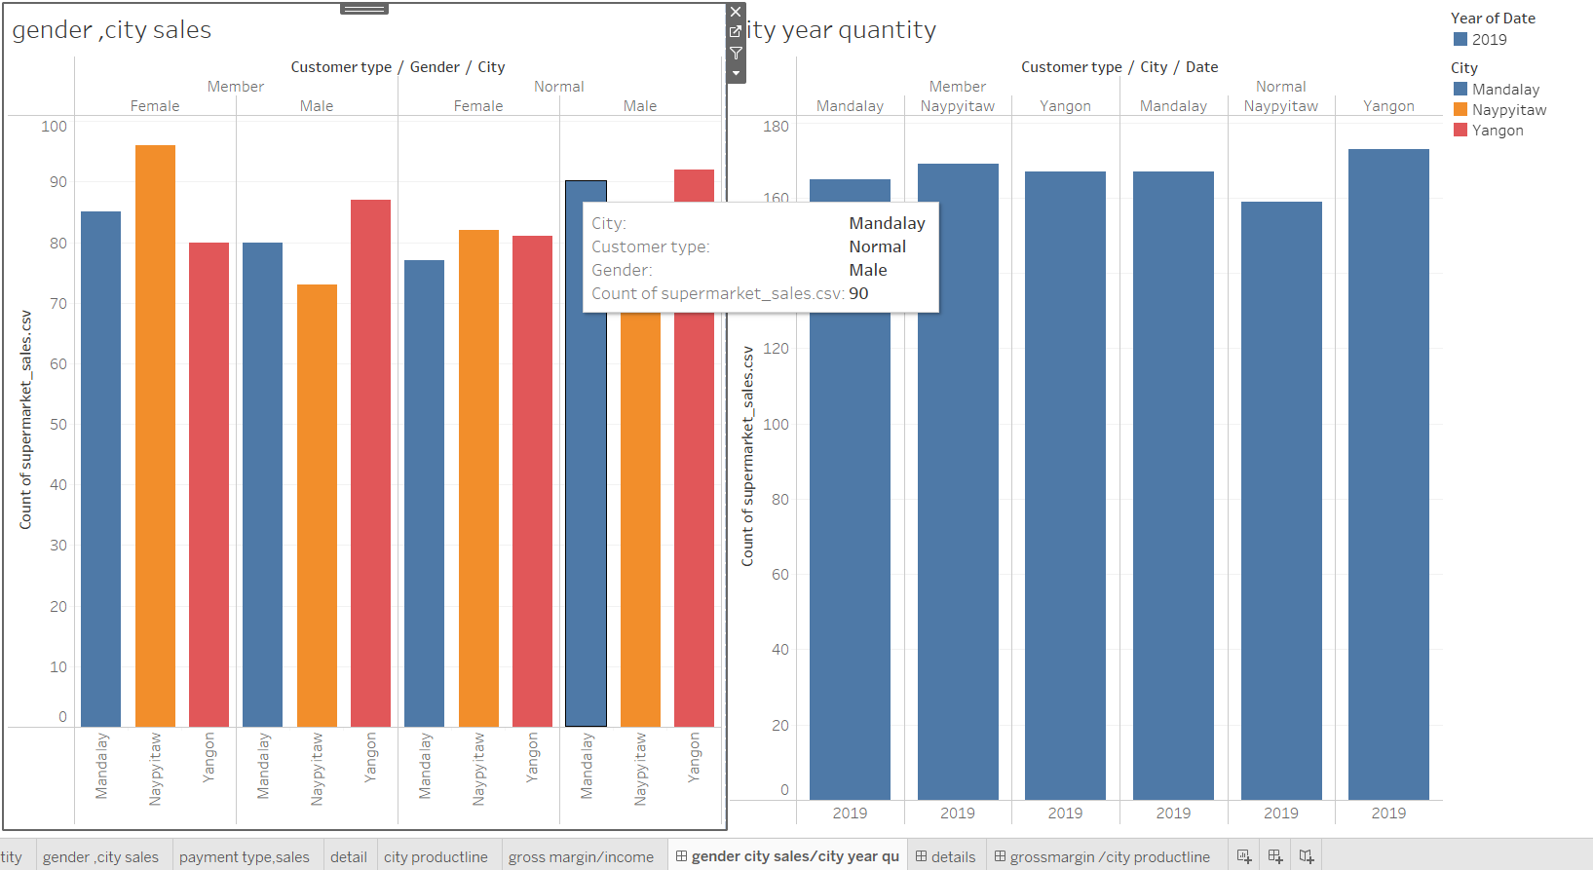
DASHBOARD

Slide 16
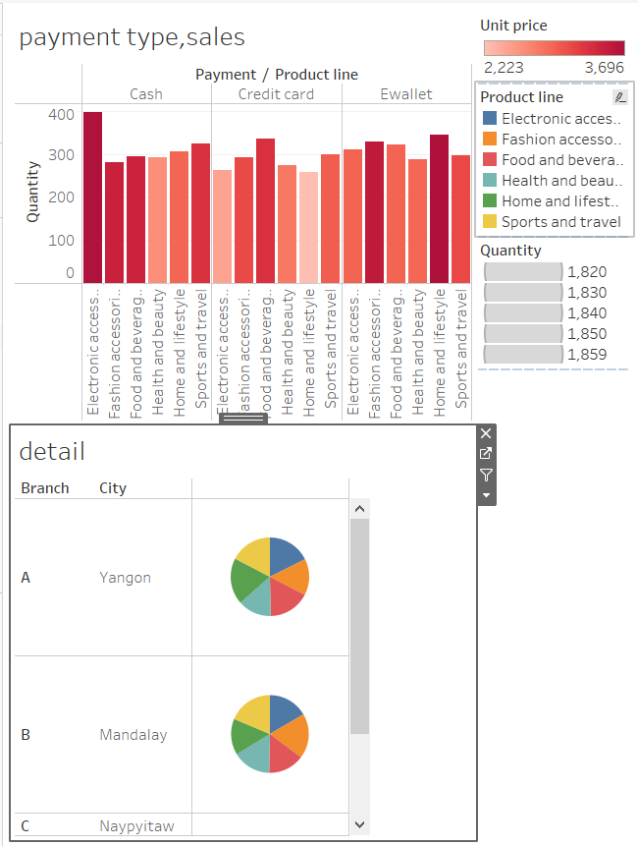

Slide 17
